Slide 1

November 27, 2024
Project 2
Customer insight analysis of borrowing money
Duc Minh Nguyen

Slide 2


Contents
1.
Introduction
2.
Customer behavior insights
3.
Recommendation

Slide 3









I am receiving an email of my company, their strategy is to attract new borrowers and finding a solution to avoid high risk borrowers.
The financial bank has collected 1K of data values of their customers. However, the datasets contains NULL values nearly half of the dataset.
Their saving amount, credit amount and duration
High or low risk of the customers are
Age, gender, their jobs, and housing
Our targets are attracting more new customers, avoiding high risk as much as possible.
Figuring out purpose trend of what people spend most of their loan
Based on their credit amount, saving amount and duration. Then, we can find who are high/low risk
Based on the dataset

Slide 4
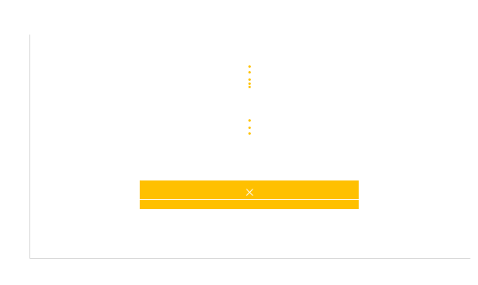
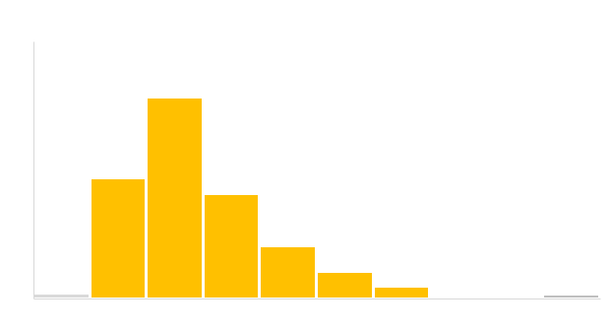
Customer age analysis
The number of people is around 15 to 45 are groups that recording the high borrowers. People aged less than 15 and larger than 70 had not much number.
Age range
These outliers will be removed

Slide 5
Customer gender analysis
More than half of people borrow loan is male. As the chart shows male spend much of their borrowing in business, car and repairs.
The percentage of male accounted for around 68% out of 100%. This means male has the larger borrower than female.
The bar chart indicates the purposes differentiate by gender (between male and female). Male spend most of their loan on car, repairs and business. For example, around 80% of male spend money on business.

Slide 6
Compare of loan purpose by age group
Young adults is the highest group who spend large amount of money in different purposes. This group is also saw the significance number in business, furniture and equipment.
Middle-aged is the second group that spend large borrow in education, home appliances, vacation and others
Age group | business | car | education | furniture and equipment | home appliances | repairs | TV | vacation and others
Senior | 8% | 8% | 4% | 4% | 0% | 21% | 6% | 11%
Middle-aged | 15% | 25% | 29% | 22% | 33% | 21% | 19% | 33%
Young Adults | 75% | 66% | 64% | 73% | 67% | 57% | 73% | 56%
Young | 2% | 1% | 4% | 1% | 0% | 0% | 2% | 0%
Young adults always higher than any other groups in different purposes

Slide 7
The distribution of jobs
Young adults is a group of people who age 18-24 having at least 2 jobs, higher than any other groups.
NUMBER OF
JOBS
Age | 0 | 1 | 2 | 3
Senior | 29% | 6% | 5% | 11%
Middle-aged | 14% | 27% | 20% | 27%
Young Adults | 57% | 66% | 74% | 62%
Young | 0% | 1% | 2% | 0%
The table highlights more than 70% of young adults have at least 2 jobs. However, seniors is the group having nearly 30% of people who does not get a job.

Slide 8

People are usually borrowing money from group of young adults.
They borrow for many purposes such as car, business, repairs, education, furniture and equipment.
They are a group aged around 18 to twenties, so business and education are their preferences. They have at least 2 jobs to earn money, so they invest more in that two segments, but for seniors, this group has the highest number of people do not get a job due to many reasons: (1) some of them are living with pension or living in retirement home

Slide 9
Compare people types of housing and their risk
The distribution between high and low risk based on types of house indicates a clear picture and the percentage of people own a house is larger than others.
People who have house accounted for around 3 times higher than rented and no housing
The risk of no housing is quite as same as rented house, with the number is 55%.
People who own house is more safer with the risk is just 40%

Slide 10
Distribution of high risk and low risk according to duration and credit amount
The distribution between high and low risk based on the loan package and duration suggest that high risk when loan is big and the duration is long.
!
The more money they borrow, the more time they have to pay all that loan. The high risk of customers are
The least money they borrow, the lowest risk they have

Slide 11



In order to successful | Avoid high risk loan and focus on what needed
Personalization
We can attract more customers by depending on their purposes to customized their borrows such as buying furniture and equipment (73%) or investing in business (75%). Then we will have a promotion for them.
Avoiding huge credit amount and long duration. If needed, we can require more tangible assets such as housing (for large loan), car, etc… and more documents about that customer.
Customized their loan packages based on their need. For example, if they want to borrow for education, we can design their loan that low interest for them

